Slide 1
(U) MATLAB Tools Adaptive CFAR Processor
Jeff Hole

Slide 2
Current Capabilities
1-dimensional CFAR
Arbitrary number of training cells and guard cells for both sides of the cell-under-test (CUT)
A signal matrix can be input (NxM) and an argument specifying which dimension to apply the CFAR across
Utilizes vectorized MATLAB features for fast operation
2-dimensional CFAR
Arbitrary number of training cells in both dimensions for number of training cells and guard cells.
Currently limited to centered CUT in both dimensions

Slide 3
Things To Add/Explore
Independent variance measures on left and right side training cells
Weight sides differently based on relative magnitude (small feature extraction might perform better)

Slide 4










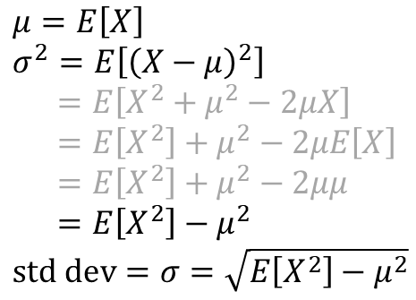




Adaptive CFAR Thresholding
Training
CUT
Training
$$\vec{x}$$
Full averaging CFAR
(both sides used together)
$$μ=E\left[X\right] \\ σ^{2}=E\left[{\left(X−μ\right)}^{2}\right] \\ =E\left[X^{2}+μ^{2}−2μX\right] \\ =E\left[X^{2}\right]+μ^{2}−2μE\left[X\right] \\ =E\left[X^{2}\right]+μ^{2}−2μμ \\ =E\left[X^{2}\right]−μ^{2} \\ \text{std} \text{dev}=σ=\sqrt{E\left[X^{2}\right]−μ^{2}}$$
$${\vec{x}}^{2}$$
$$E\left[⋅\right]$$
$$E\left[⋅\right]$$
$$μ$$
$$μ^{2}$$
$$−μ^{2}$$
$$E\left[{\vec{x}}^{2}\right]$$
-1
$$E\left[X^{2}\right]−μ^{2}=σ^{2}$$
$$\sqrt{⋅}$$
$$μ$$
$$N_{σ}$$
$$σ$$
$$σN_{σ}+μ$$

Slide 5















Independent Left/Right Training Cells
Left-side Training
CUT
Right-side Training
$$\vec{x}$$
Cell
processing
Single-sided CFAR
(both sides independent)
Cell
Processing
$${\vec{x}}^{2}$$
$$E\left[⋅\right]$$
$$E\left[⋅\right]$$
$$T_{right}=σN_{σ}+μ$$
$$μ$$
$$μ^{2}$$
$$−μ^{2}$$
$$E\left[{\vec{x}}^{2}\right]$$
-1
Compare
$$E\left[{\vec{x}}^{2}\right]−μ^{2}=σ^{2}$$
$$\sqrt{⋅}$$
$$μ$$
$$N_{σ}$$
$$σ$$
$$T_{left}=σN_{σ}+μ$$

